Slide 1
Winter Term 22-23 Meta-Reinforcement Learning for Self-Adaptive Systems Lecture-8: Meta-Reinforcement Learning
Prof. Dr. Holger Giese (holger.giese@hpi.uni-potsdam.de)
Christian Medeiros Adriano (christian.adriano@hpi.de) - “Chris”
He Xu (he.xu@hpi.de)
Sona.Ghahremani (sona.ghahremani@hpi.de)

Slide 2
Index
Recap
Problem Statement of Meta-RL
Black-Box Meta-RL
Optimization-Based Meta RL
Future tasks
Exploration in Meta-RL

Slide 3
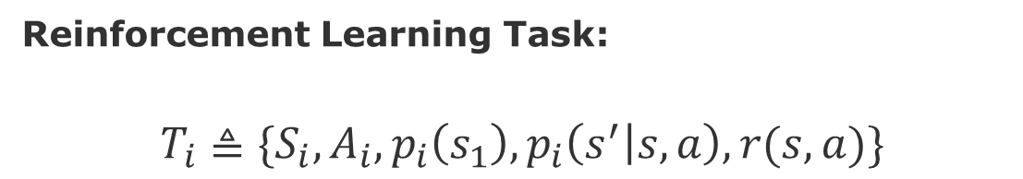
Recap
Two fundamental differences RL vs Supervised Learning
Agent collects its own data (Explore & Exploit problem)
Rewards instead of labels (Credit assignment problem)
Reinforcement Learning Task:
$$T_{i}≜\{S_{i}, A_{i}, p_{i}\left(s_{1}\right), p_{i}\left(s^{′} | s,a\right),r(s,a)\}$$
state space
action space
Initial state distribution
dynamics
reward
Slides based on Finn, C., 2021, Stanford CS330: Deep Multi-task & Meta Learning I 2021 I Lectures 11, 12, & 13.

Slide 4
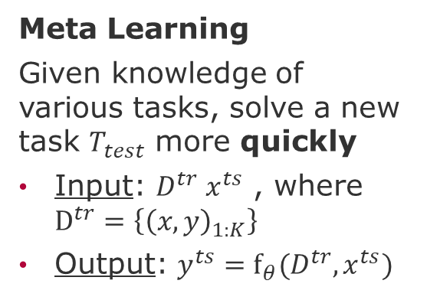
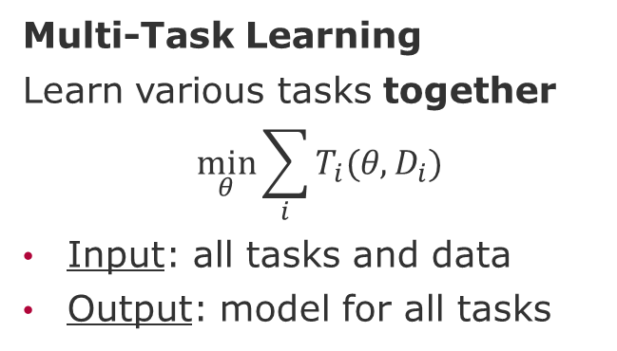
Recap
Multi-Task Learning
Learn various tasks together
$$\min_{θ}{\sum_{i}{T_{i}(θ,D_{i})}}$$
Input: all tasks and data
Output: model for all tasks
Transfer Learning
Learn target task by transferring knowledge from a source task.
Input: model of source task+ data of target task
Output: model for target task
Meta Learning
Given knowledge of various tasks, solve a new task $T_{test}$ more quickly
Input: $D^{tr} x^{ts}$ , where $D^{tr}=\left\{{\left(x,y\right)}_{1:K}\right\}$
Output: $y^{ts}=f_{θ}(D^{tr},x^{ts})$
Assumption: Tasks must share a common structure
source: Finn, C., 2021, Stanford CS330: Deep Multi-task & Meta Learning I 2021 I Lecture 11

Slide 5
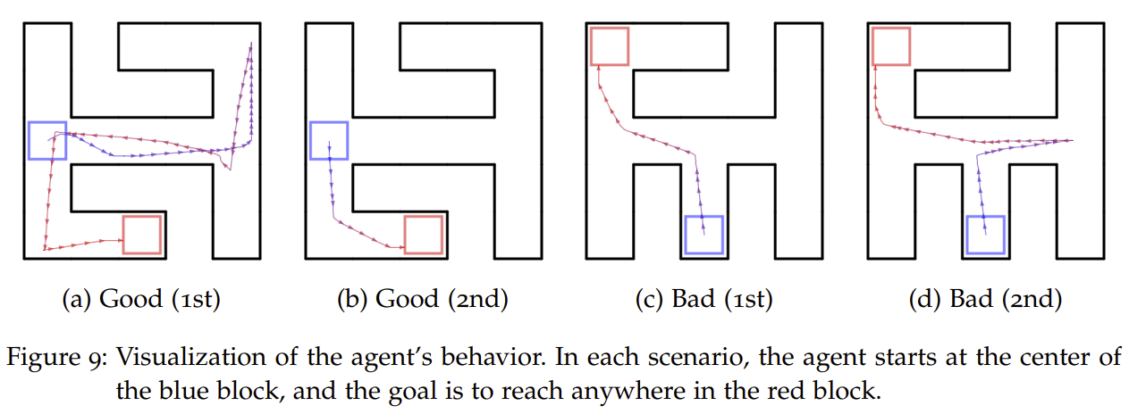
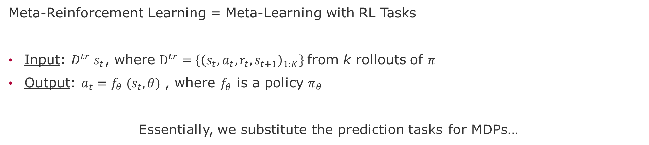
Problem Statement
Meta-Reinforcement Learning = Meta-Learning with RL Tasks
Input: $D^{tr} s_{t}$, where $D^{tr}=\left\{{\left(s_{t},a_{t}, r_{t}, s_{t+1}\right)}_{1:K}\right\}$from k rollouts of $π$
Output: $a_{t}=f_{θ} (s_{t},θ)$ , where $f_{θ}$ is a policy $π_{θ}$
Essentially, we substitute the prediction tasks for MDPs…
Given a small amount of experience, learn a new task
[Duan 2017]
Duan, Yan, 2017, Meta learning for control. PhD Dissertation, University of California, Berkeley

Slide 6
Black-Box Meta-RL

Slide 7










Blackbox Meta-RL
Blackbox neural network for policy: $a_{t}=f_{θ} (D^{tr},s_{t})$
$$a_{1}$$
$$a_{2}$$
$$a_{3}$$
$$a_{t}$$
…
$$s_{1},0$$
$$s_{2},r_{1}$$
$$s_{3},r_{2}$$
$$s_{t},r_{t+1}$$
$$D^{tr}$$
$$query set$$
Differences from Regular RL
Passes the Reward as input and trained across multiple MDPs
Keeps the hidden state across multiple episodes within a tasks
source: Finn, C., 2021, Stanford CS330: Deep Multi-task & Meta Learning I 2021 I Lecture 11

Slide 8




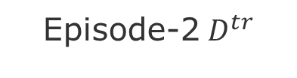

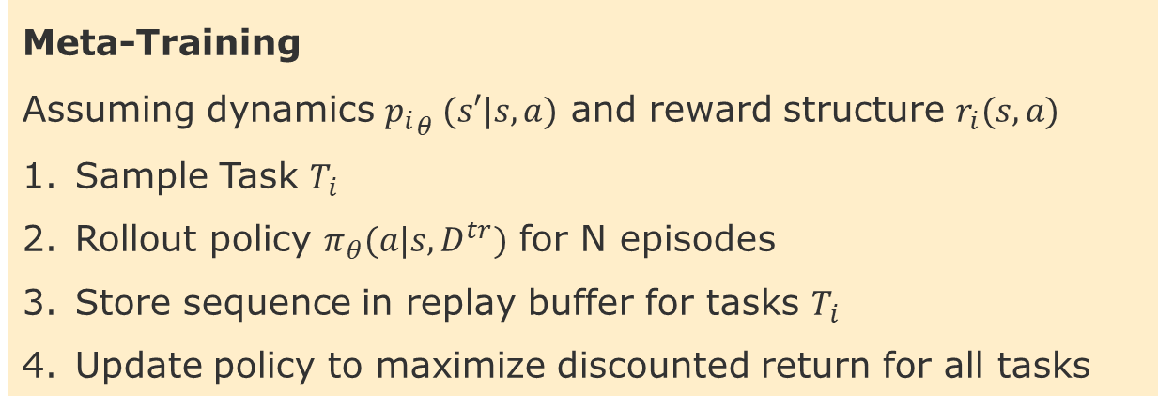




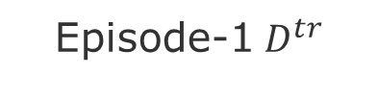







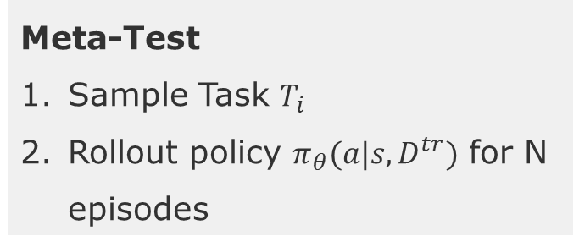
Blackbox Meta-RL – Meta-Training step-by-step
$$a_{1}$$
$$a_{2}$$
$$a_{3}$$
$$a_{t}$$
$$a_{1}$$
$$a_{2}$$
$$a_{3}$$
$$a_{t}$$
…
…
$$s_{1},0$$
$$s_{2},r_{1}$$
$$s_{3},r_{2}$$
$$s_{T},r_{T−1}$$
$$s_{1},0$$
$$s_{2},r_{1}$$
$$s_{3},r_{2}$$
$$s_{T},r_{T−1}$$
Episode-1${ D}^{tr}$
Episode-2${ D}^{tr}$
Meta-Training
Assuming dynamics ${p_{i}}_{θ} (s′|s,a)$ and reward structure $r_{i}(s,a)$
Sample Task $T_{i}$
Rollout policy $π_{θ}(a|s,D^{tr})$ for N episodes
Store sequence in replay buffer for tasks $T_{i}$
Update policy to maximize discounted return for all tasks
Meta-Test
Sample Task $T_{i}$
Rollout policy $π_{θ}(a|s,D^{tr})$ for N episodes
source: Finn, C., 2021, Stanford CS330: Deep Multi-task & Meta Learning I 2021 I Lecture 11

Slide 9
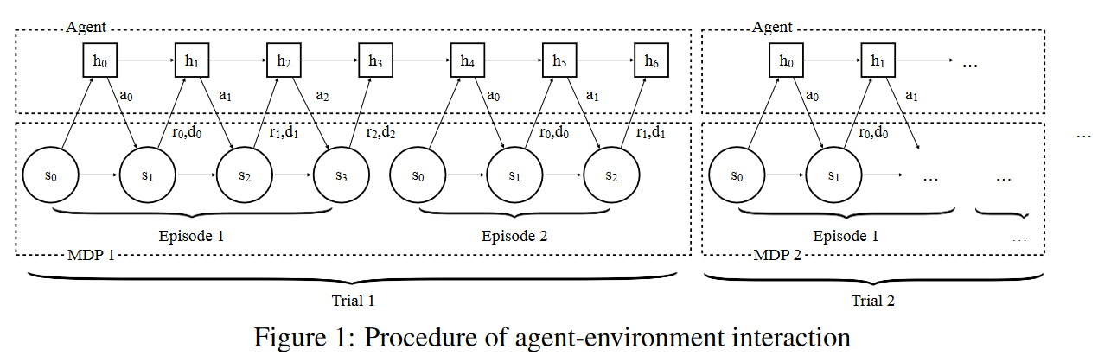
RL² Fast reinforcement learning via slow reinforcement learning [Duan 2016]
RNN Architecture + TRPO/A3C (On-Policy)
source: Finn, C., 2021, Stanford CS330: Deep Multi-task & Meta Learning I 2021 I Lecture 11
Duan, Yan, et al. "Rl $^ 2$: Fast reinforcement learning via slow reinforcement learning." arXiv preprint arXiv:1611.02779 (2016).
Notes:
RL2 fast reinforcement learning via slow reinforcemnent

Slide 10
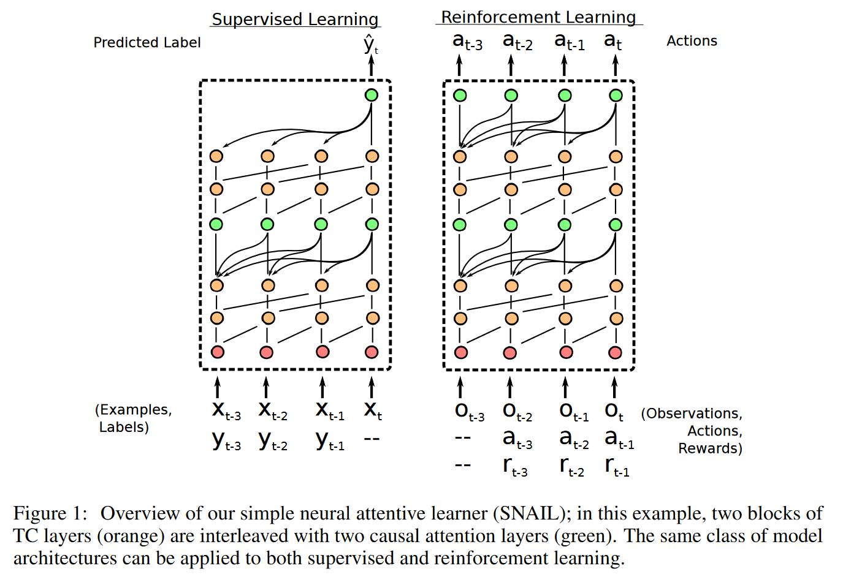
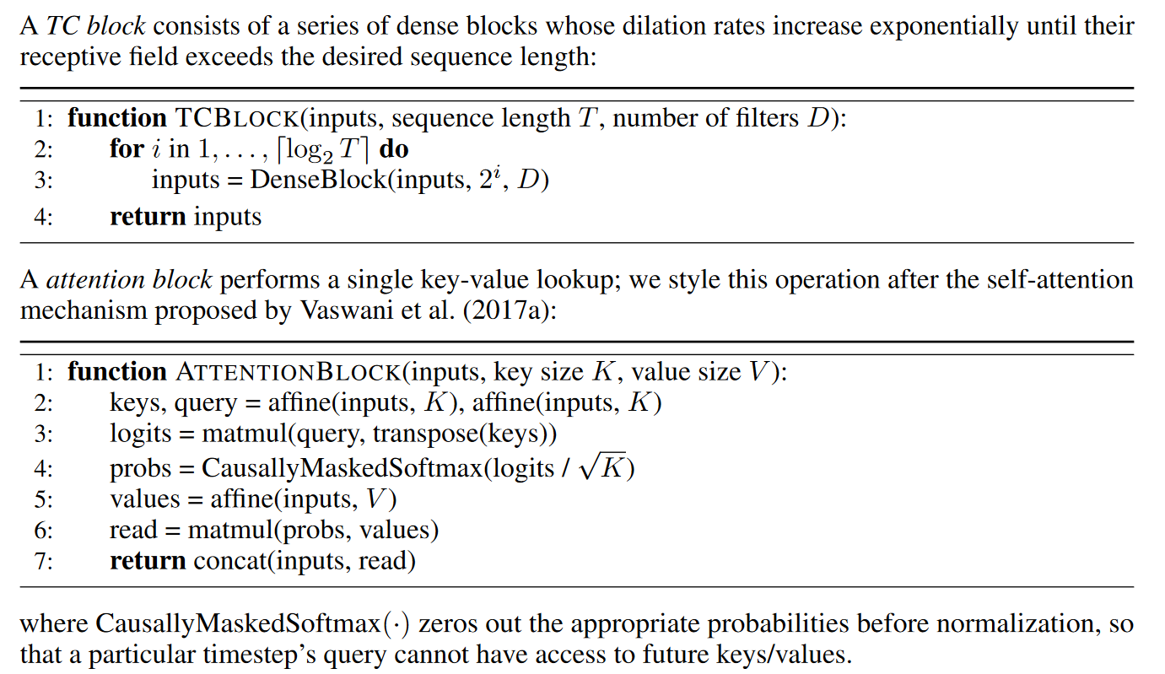
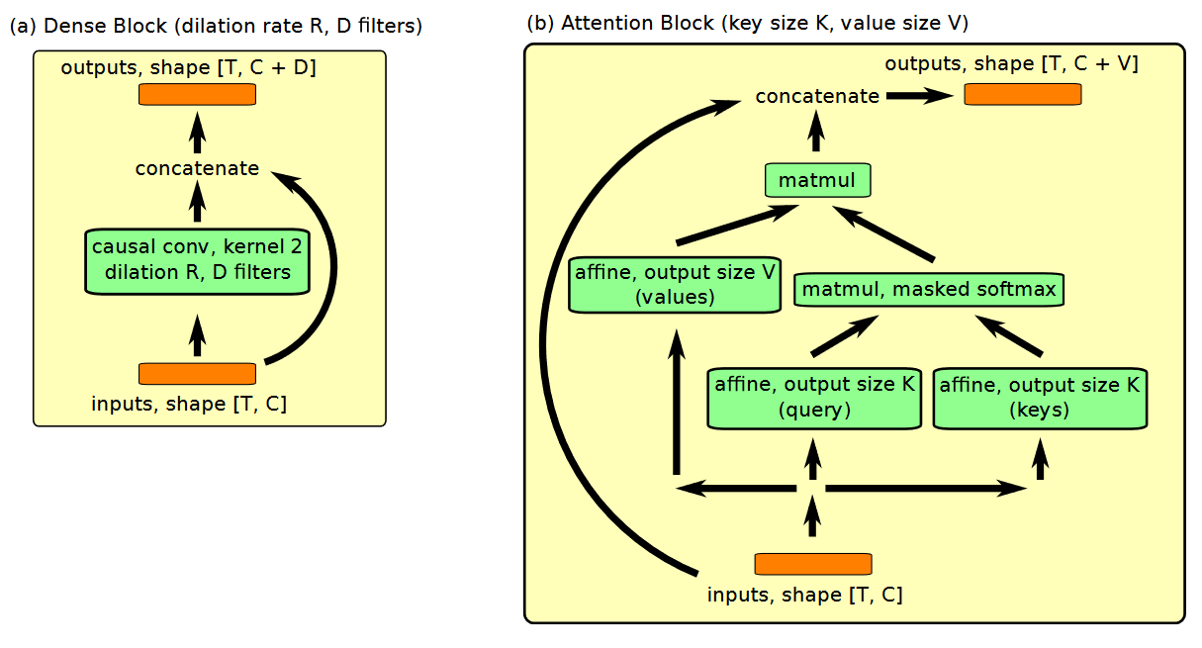
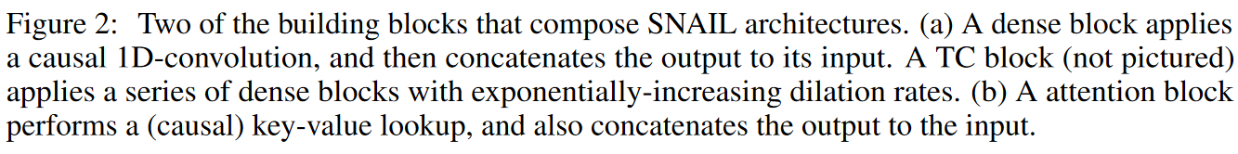
TRPO (on-policy) + Attention [Mishra 2017]
Mishra, Nikhil, et al. "A simple neural attentive meta-learner." arXiv preprint arXiv:1707.03141 (2017).

Slide 11
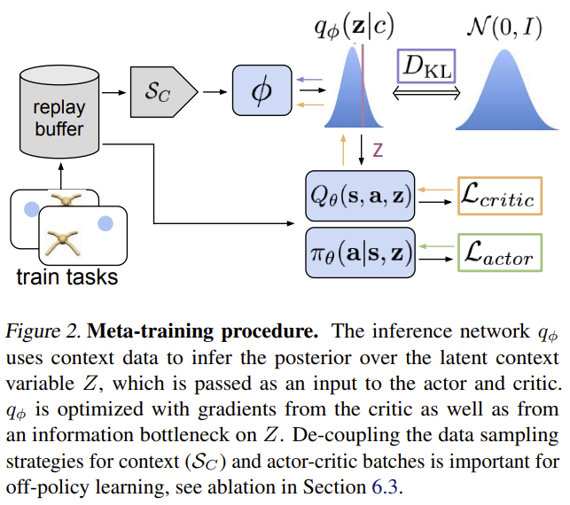

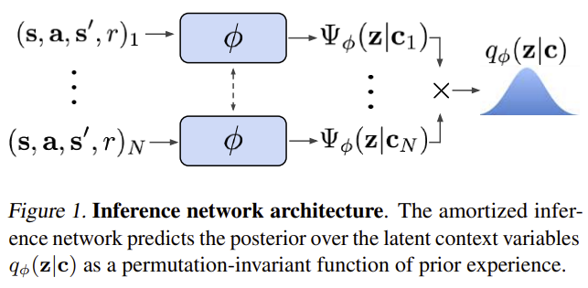
SAC Off-policy / Probabilistic Context Variables [Rakelly 2019]
Motivation - Continuous Actions, e.g., different directions, velocities, physical dynamics
Posterior Sampling and Exploration via Latent Contexts
Probabilistic Latent Context
permutation-invariant representation for $q_{φ}$
Rakelly, Kate, et al. "Efficient off-policy meta-reinforcement learning via probabilistic context variables." International conference on machine learning. PMLR, 2019.

Slide 12
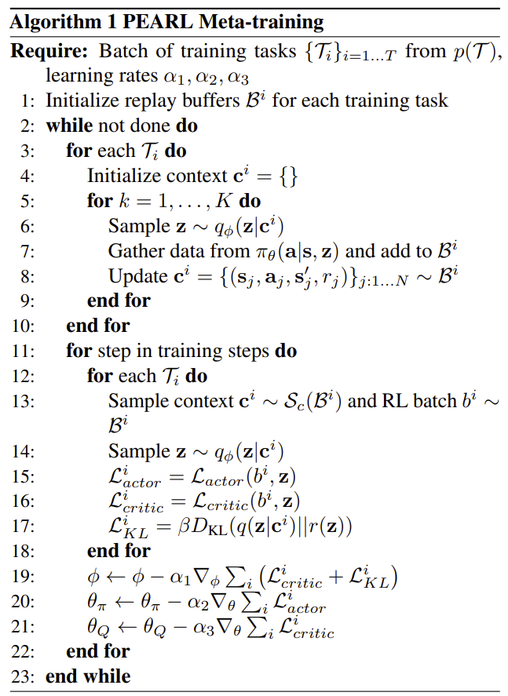
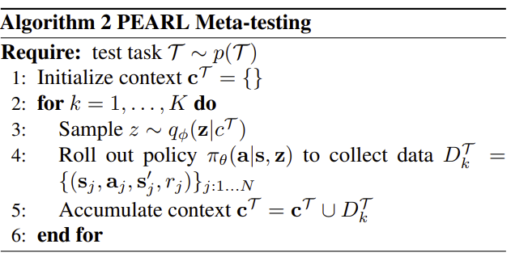


Meta-RL with Probabilistic Context Variables [Rakelly 2019]
Algorithm
Rakelly, Kate, et al. "Efficient off-policy meta-reinforcement learning via probabilistic context variables." International conference on machine learning. PMLR, 2019.

Slide 13
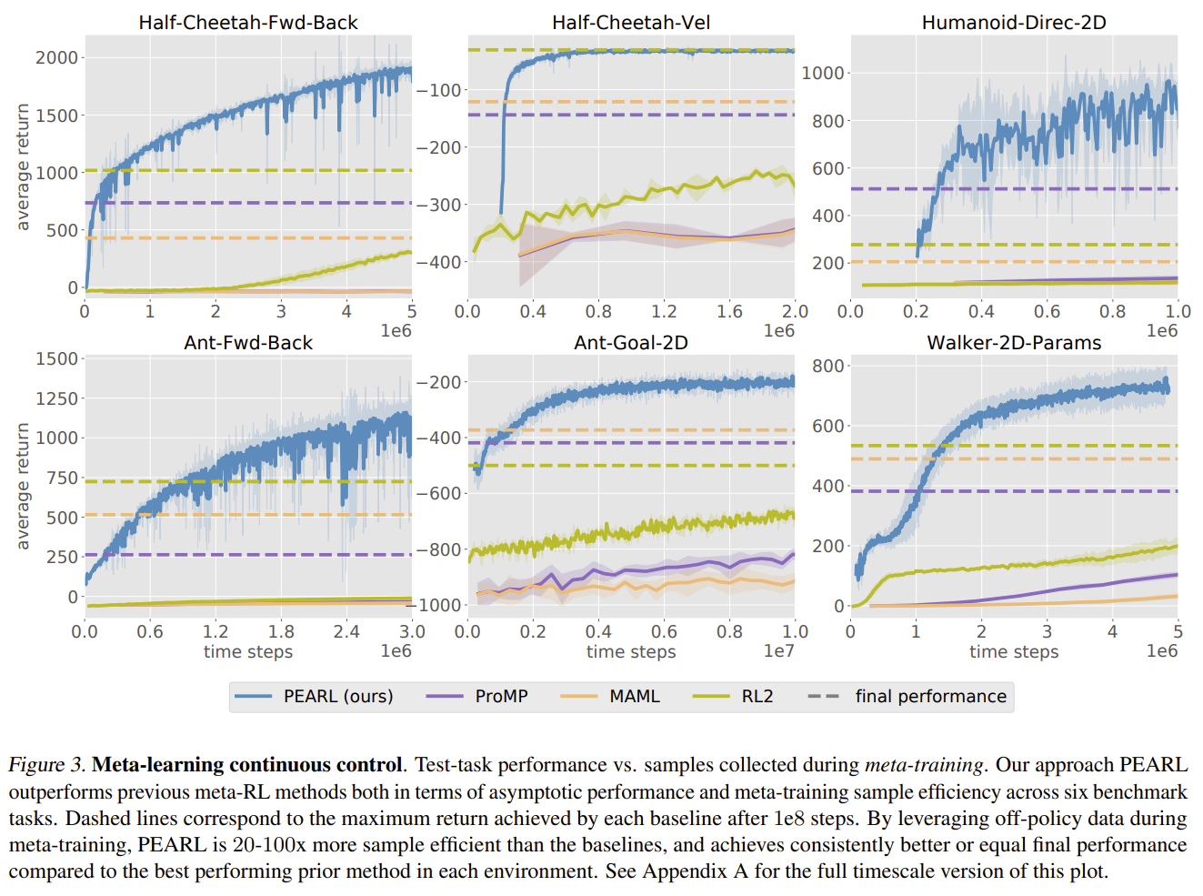
Meta-RL with Probabilistic Context Variables [Rakelly 2019]
Better efficiency
PEARL = Value-Based
Policy-Based
PropMP
MAML
RL2
Dotted lines correspond to the asymptotic convergence.
Rakelly, Kate, et al. "Efficient off-policy meta-reinforcement learning via probabilistic context variables." International conference on machine learning. PMLR, 2019.

Slide 14
Black-Box Meta-RL Pros-Cons
Pros
General
Expressive
Versatility (diversity of architectural design choices)
Cons
Difficult to optimize
Inherits sample inefficiencies from the RL optimizer

Slide 15
Optimization-Based Meta-RL

Slide 16
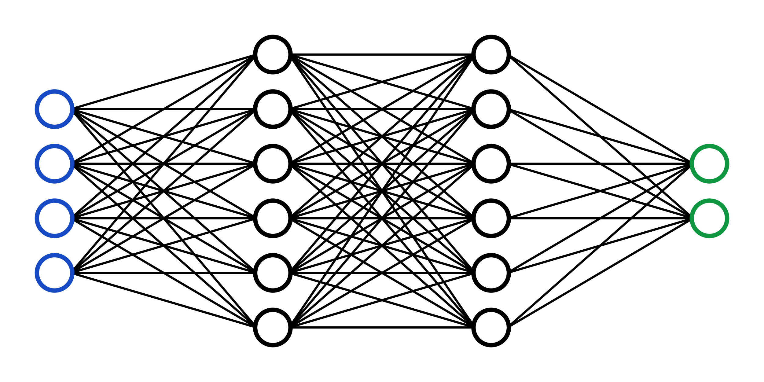



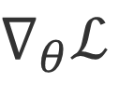
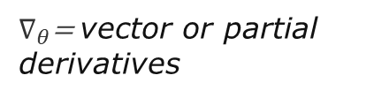

Optimization-Based Meta-RL
Insight: embed optimization in the inner loop of the learning process
$$φ_{i}$$
$∇_{θ}$= vector or partial derivatives
${∇_{θ}ℒ}_{ }$
$$a_{t}$$
$$D^{tr}$$
K-rollouts from $π_{θ}$
$$s_{t}$$
Approaches to the Inner-Loop | Policy-Gradient | Q-Learning | Model-Based RL
Pros | Gradient-based | Sample efficient | Gradient-based Sample efficient
Cons | Sample-inefficient Worsens with sparse rewards | Dynamic programming (many steps)
source: Finn, C., 2021, Stanford CS330: Deep Multi-task & Meta Learning I 2021 I Lecture 11
Notes:
https://youtu.be/dYmJd_fJLW0?list=PLoROMvodv4rMIJ-TvblAIkw28Wxi27B36&t=2842

Slide 17
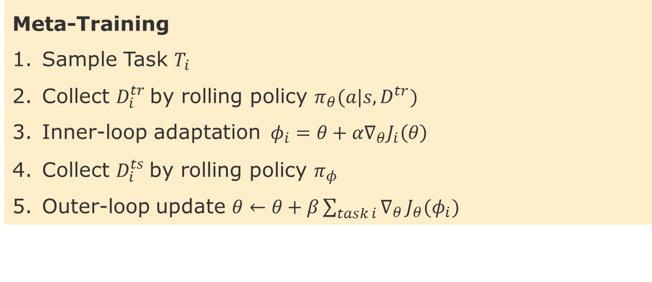
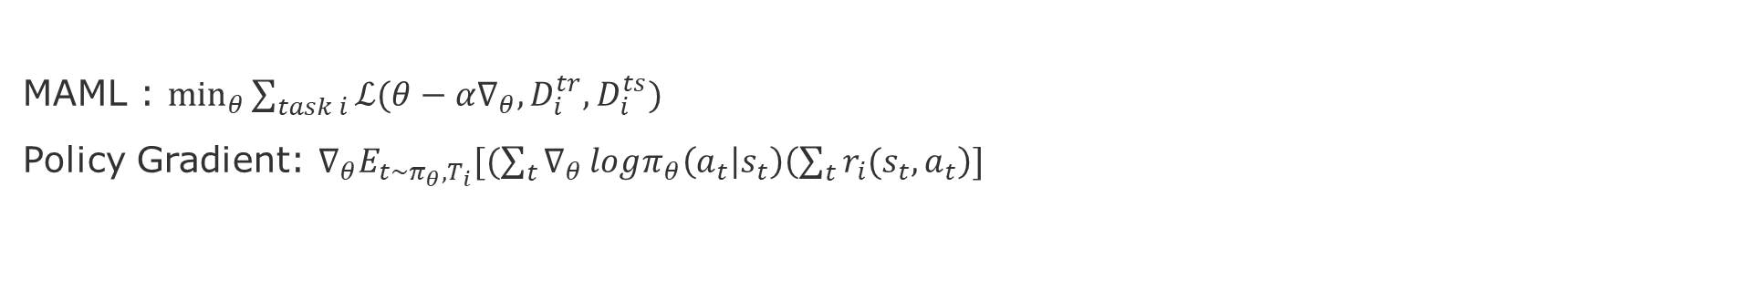
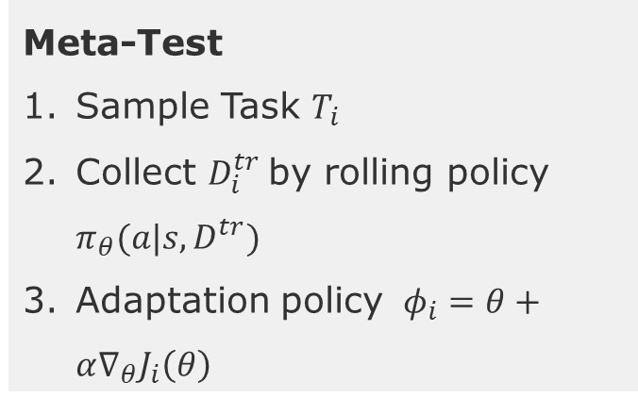
MAML with Policy Gradients
MAML : $\min_{θ}{\sum_{task i}{ℒ(θ−α∇_{θ},D_{i}^{tr},D_{i}^{ts})}}$
Policy Gradient: $∇_{θ}E_{t\sim π_{θ},T_{i}}[(\sum_{t}{∇_{θ}}logπ_{θ}\left(a_{t} | s_{t}\right)\left(\sum_{t}{r_{i}(s_{t},a_{t}}\right)]$
Meta-Training
Sample Task $T_{i}$
Collect $D_{i}^{tr}$by rolling policy $π_{θ}(a|s,D^{tr})$
Inner-loop adaptation $φ_{i}=θ+α∇_{θ}J_{i}\left(θ\right)$
Collect $D_{i}^{ts}$by rolling policy $π_{φ}$
Outer-loop update $θ←θ+β\sum_{task i}{∇_{θ}}J_{θ}(φ_{i})$
Meta-Test
Sample Task $T_{i}$
Collect $D_{i}^{tr}$by rolling policy $π_{θ}(a|s,D^{tr})$
Adaptation policy $φ_{i}=θ+α∇_{θ}J_{i}\left(θ\right)$

Slide 18
MAML with Model-Based RL [Nagabandi 2018]
Goal: Learning online adaptation
Context RL agent policies fail at test time when facing unexpected perturbations or unseen situations
Comparatively, humans can quickly adapt their behavior to unseen physical perturbations [Braun 2009]
The secret is that human learned to adapt to changes.
Challenges -> Mitigation
Changes induce sparsity -> Sample efficiency
Tasks as a single step, instead of a trajectory -> Redefine “task”, e.g., state-space partitions, disturbance experience, new goal.
Instead of a global model -> Various subspaces of the model
Instead of optimal everywhere -> improve incrementally and opportunistically
D. A. Braun, A. Aertsen, D. M. Wolpert, and C. Mehring. Learning optimal adaptation strategies in unpredictable motor tasks. Journal of Neuroscience, 2009
Notes:
Adults can quickly learn to walk using crutches or kids can adapt to walking on ice after learning to walk on grass or carpet.

Slide 19

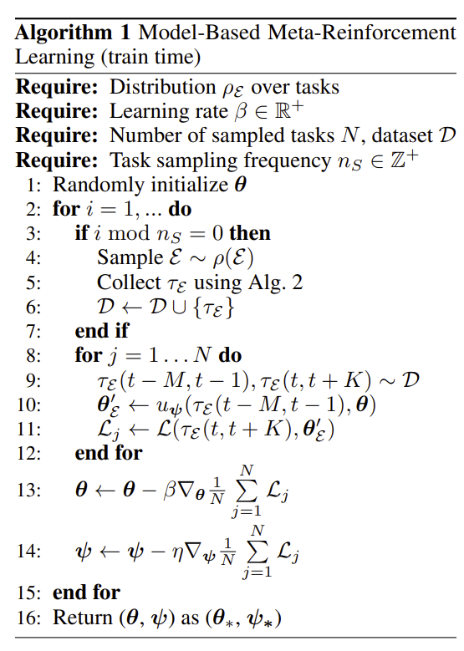
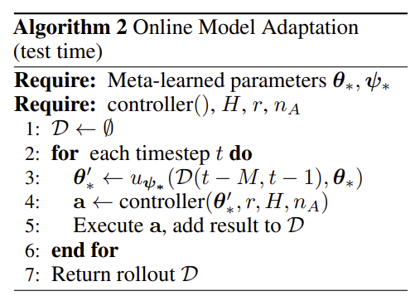




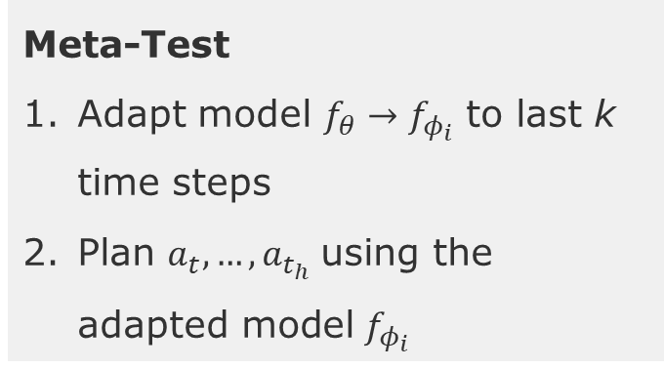





MAML with Model-Based RL [Nagabandi 2018]
$u_{ψ}$= learning procedure
Meta-Training
$$s_{t−k:t},a_{t−k:t}$$
Tasks: windows in time
$$D_{t}^{tr}$$
$$D_{t}^{ts}$$
time
$$s_{t:t+h},a_{t:t+h}$$
Meta-Test
Adapt model $f_{θ}→f_{φ_{i}}$ to last k time steps
Plan $a_{t}, …, a_{t_{h}}$using the adapted model $f_{φ_{i}}$
source: Finn, C., 2021, Stanford CS330: Deep Multi-task & Meta Learning I 2021 I Lecture 11
Nagabandi, Anusha, et al. "Learning to adapt in dynamic, real-world environments through meta-reinforcement learning." arXiv:1803.11347 (2018).

Slide 20
Black-Box vs Optimization-Based Meta-RL
 | Black-Box Meta-RL | Optimization-Basd Meta-RL
Pros | General & expressive Versatile (different architecture designs and objectives) | Built-in inductive bias Easier to combine with policy-gradient and model-based methods
Cons | Difficult to optimize | Policy-gradient has high variance (noise) Difficult to combine with value-based RL-methods
Notes:
source: Finn, C., 2021, Stanford CS330: Deep Multi-task & Meta Learning I 2021 I Lecture 11
https://youtu.be/gUutjhnc2Q4?list=PLoROMvodv4rMIJ-TvblAIkw28Wxi27B36&t=4512

Slide 21
Tomorrow
@juergen -> Finn, Chelsea, et al. "Online meta-learning." International Conference on Machine Learning. PMLR, 2019.
@Finn Kaiser -> Antoniou, Antreas, Harrison Edwards, and Amos Storkey. "How to train your MAML." arXiv preprint arXiv:1810.09502 (2018).
@Maximilian Goetz Raghu, Aniruddh, et al. "Rapid learning or feature reuse? towards understanding the effectiveness of maml." arXiv preprint arXiv:1909.09157 (2019).

Slide 22
End
Notes:
https://www.youtube.com/watch?v=ItPEBdD6VMk

Slide 23
Future readings – Learning to Explore
@juergen -> Chen, Annie S., et al. "You Only Live Once: Single-Life Reinforcement Learning." arXiv preprint arXiv:2210.08863 (2022).
@Finn Kaiser Wang, Jane X., et al. "Learning to reinforcement learn." arXiv preprint arXiv:1611.05763 (2016).
@Maximilian Goetz -> Zang, Xinshi, et al. "Metalight: Value-based meta-reinforcement learning for traffic signal control." Proceedings of the AAAI Conference on Artificial Intelligence. Vol. 34. No. 01. 2020.

Slide 24
Future Readings – Model-Based Meta-learning
@Finn Kaiser -> Lin, Zichuan, et al. "Model-based adversarial meta-reinforcement learning." Advances in Neural Information Processing Systems 33 (2020): 10161-10173.
@juergen -> Amos, Brandon, et al. "On the model-based stochastic value gradient for continuous reinforcement learning." Learning for Dynamics and Control. PMLR, 2021.
@Maximilian Goetz -> Whittlestone, Jess, Kai Arulkumaran, and Matthew Crosby. "The societal implications of deep reinforcement learning." Journal of Artificial Intelligence Research 70 (2021): 1003-1030.

